Slide 1
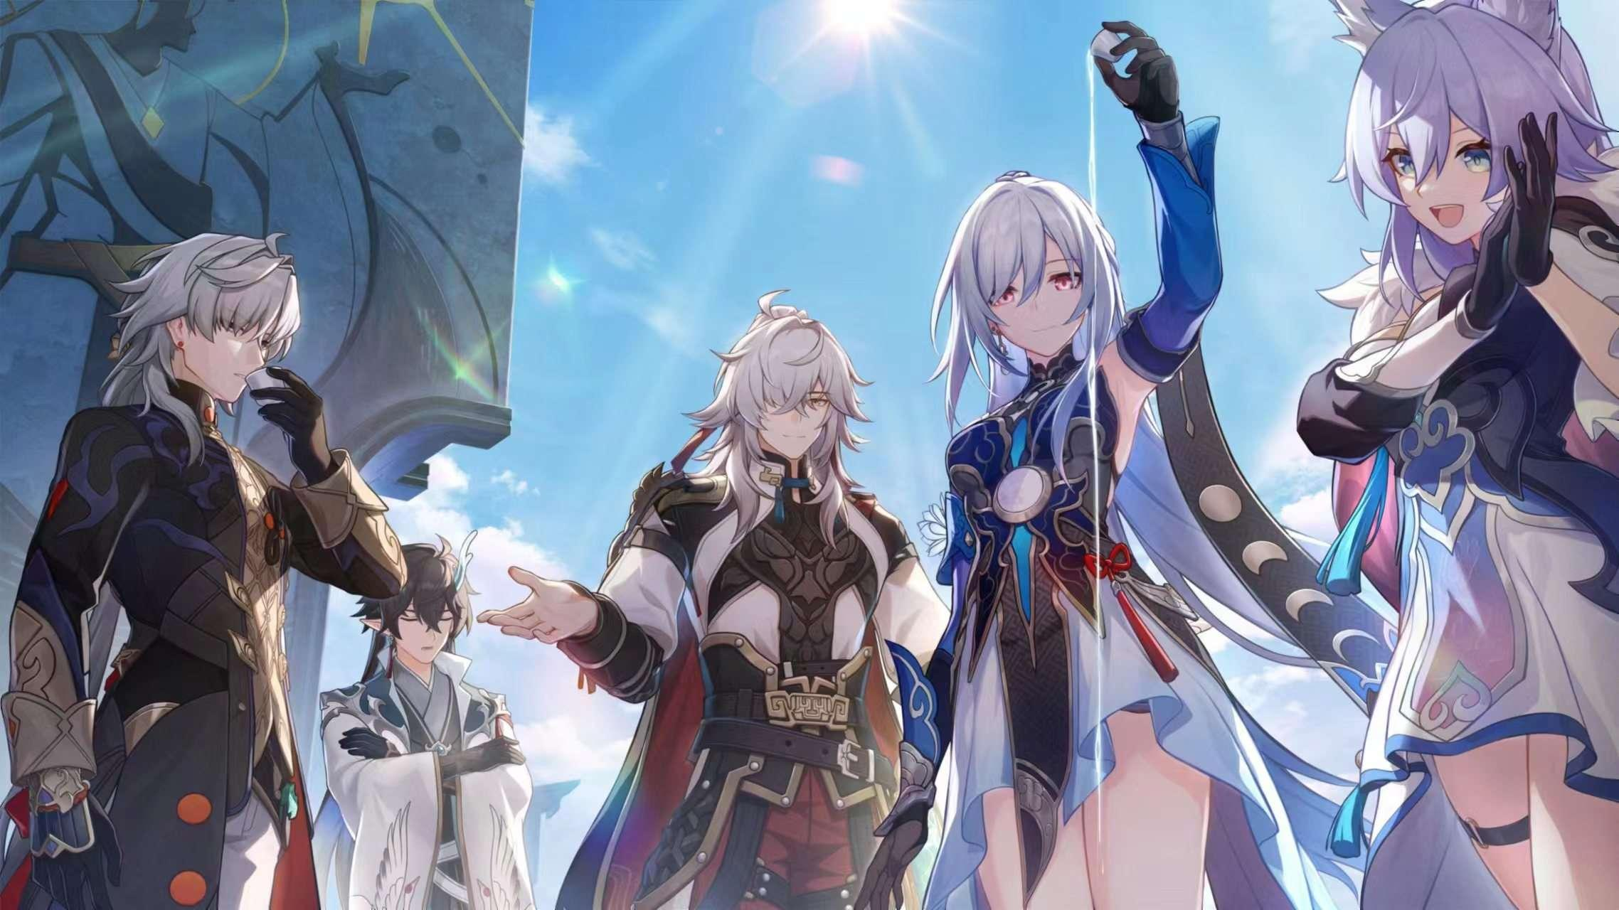
RDBMS Designed for Beginners about
Hongkai: Star Rail
by Group 7

Slide 2
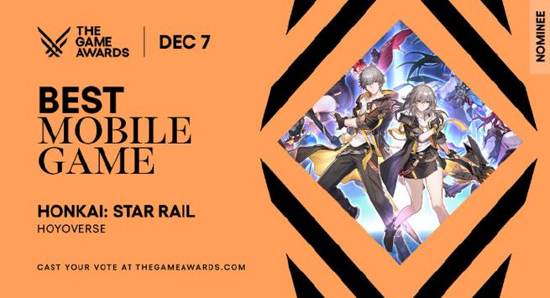
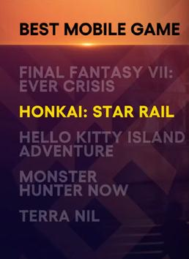
Background: what is Hongkai: Star Rail
2023 TGA best mobile game
A turn-based role-playing game
UTC+8 10:00 Dec 8

Slide 3
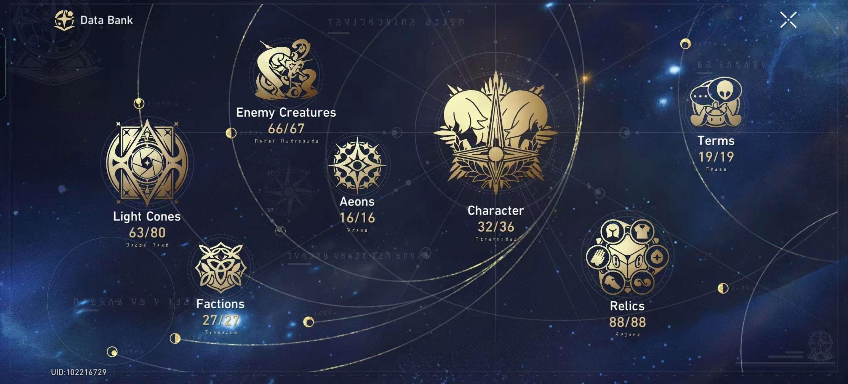
Background: why this topic?
Initially, we are inspired by the ‘Data Bank’ in the game.

Slide 4
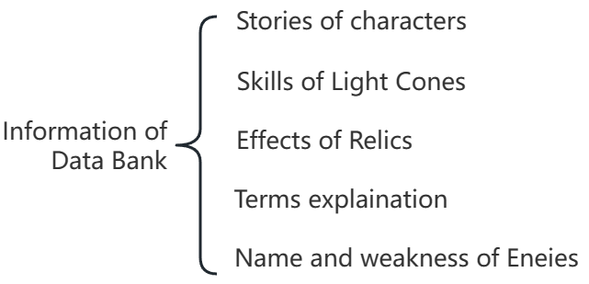
Background: why this topic?
The information is not enough!
Data Bank is story-biased.
no need
√
√
no need
no need

Slide 5
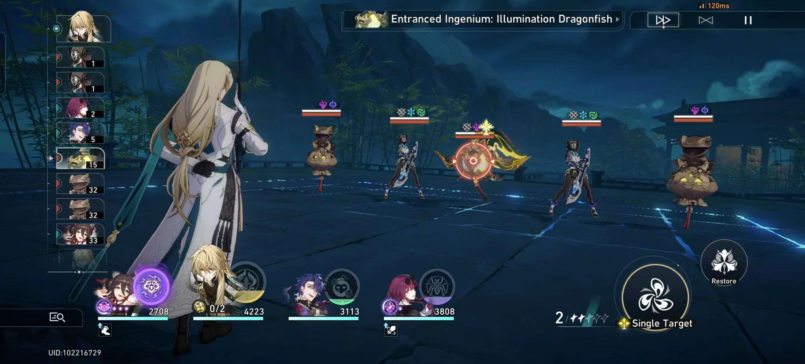
Background: why this topic?
What do we need? Combat-related data!

Slide 6
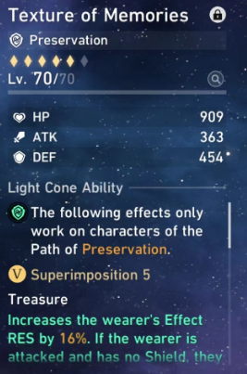
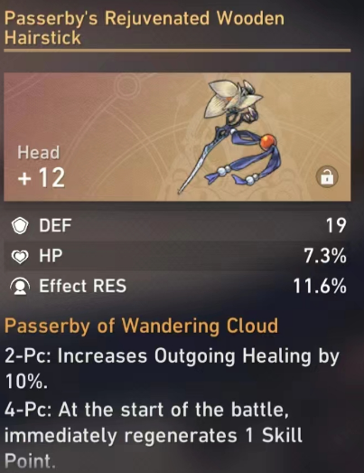
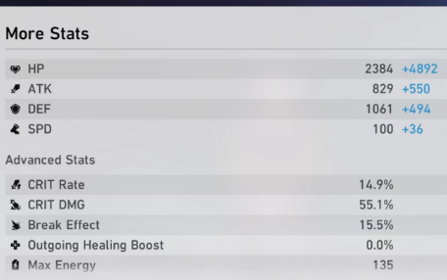
Background: why this topic is worth exploring?
Why it can be done with RDBMS?
In order to advance the game process, we should focus on the static data out of the combat, especially suit-matching.
=> Only fixed panel data is considered.

Slide 7
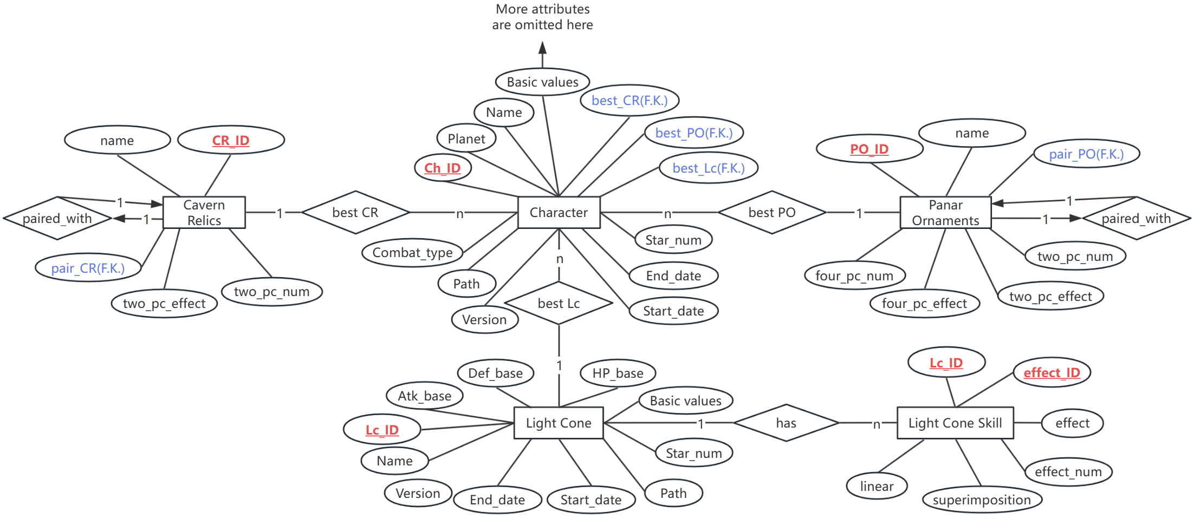
ER

Slide 8
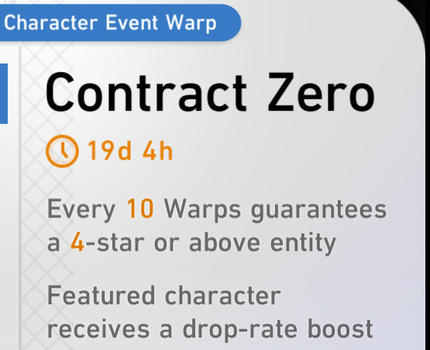
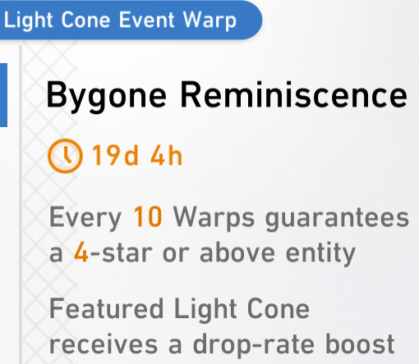
EER(partial)
character
light cone
d
d
limited
character
resident character
limited
light cone
resident light cone
The subtypes that belongs to one type are still included in the same table.

Slide 9
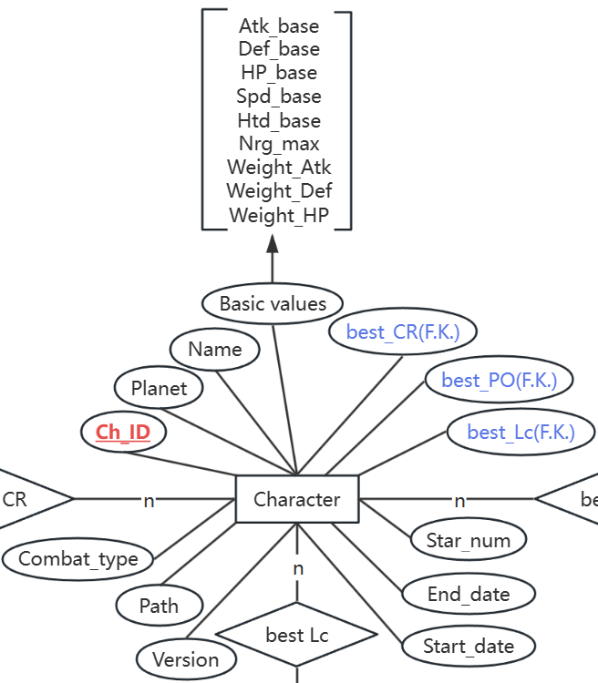
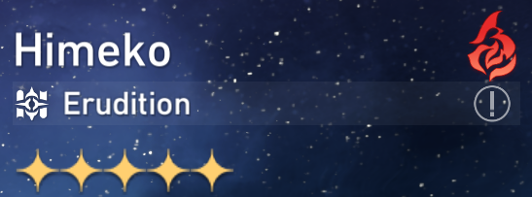
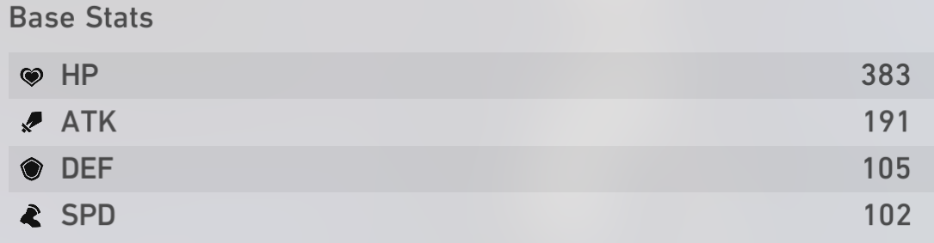
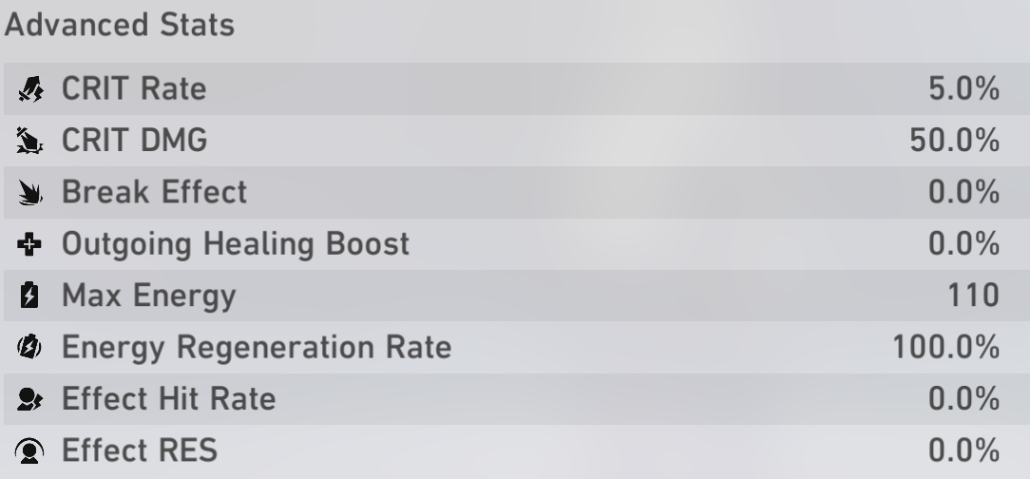
Logical Design: Character
Name
Combat Type
connecting character with other entities
Path
Star_num
Conforms to BCNF:
All other attributes can be uniquely determined by Ch_ID

Slide 10
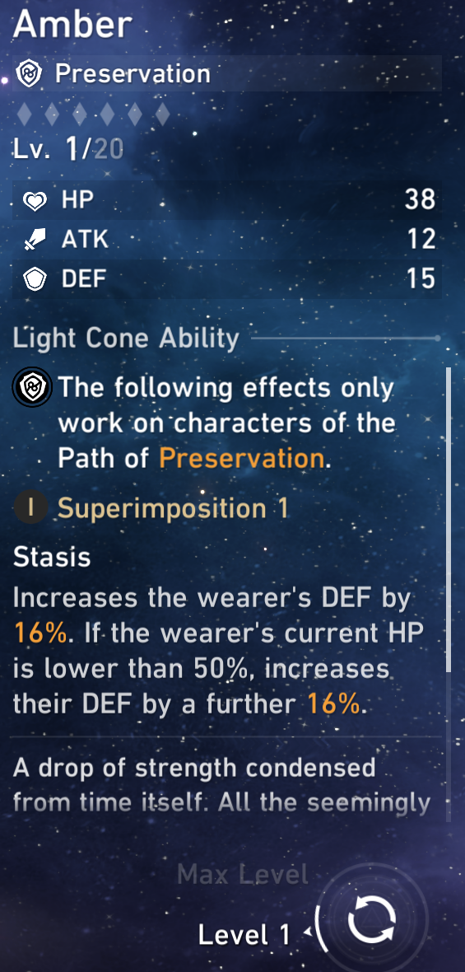
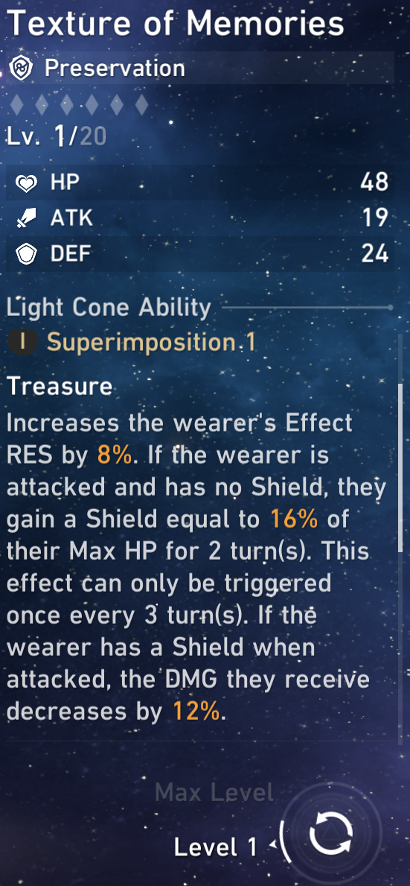
Logical Design: Light Cone
Problem:
The number of effects of one light cone varies.
Main idea of re-organizing:
Break them down!
First split each of the effect
Then split the direction and number of one effect

Slide 11
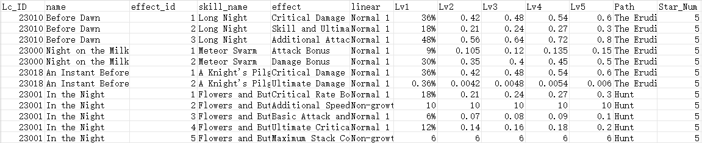
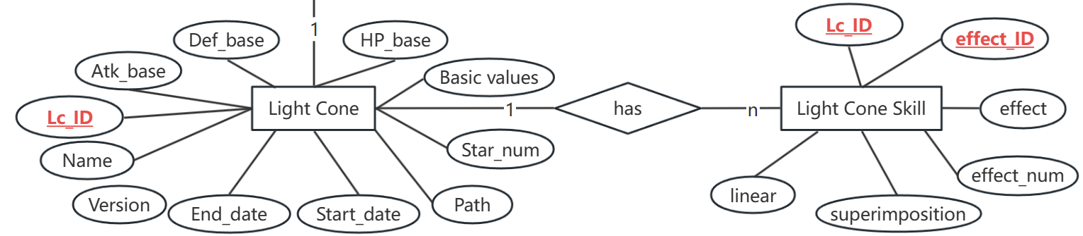
Logical Design: Light Cone
Unlike the characters, light cones cannot be uniquely determined by Lc_ID only.
Add effect_ID combined with Lc_ID to form the primary key
primary key
direction of effect
numbers of effect
‘lightcone_skills.csv’

Slide 12
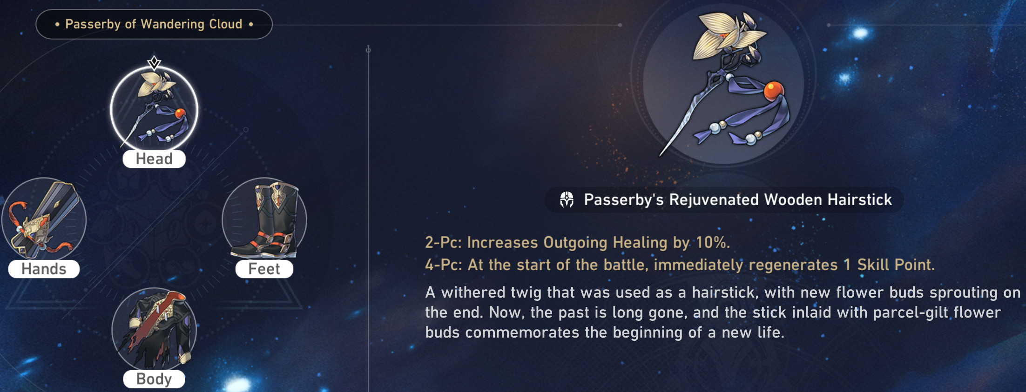
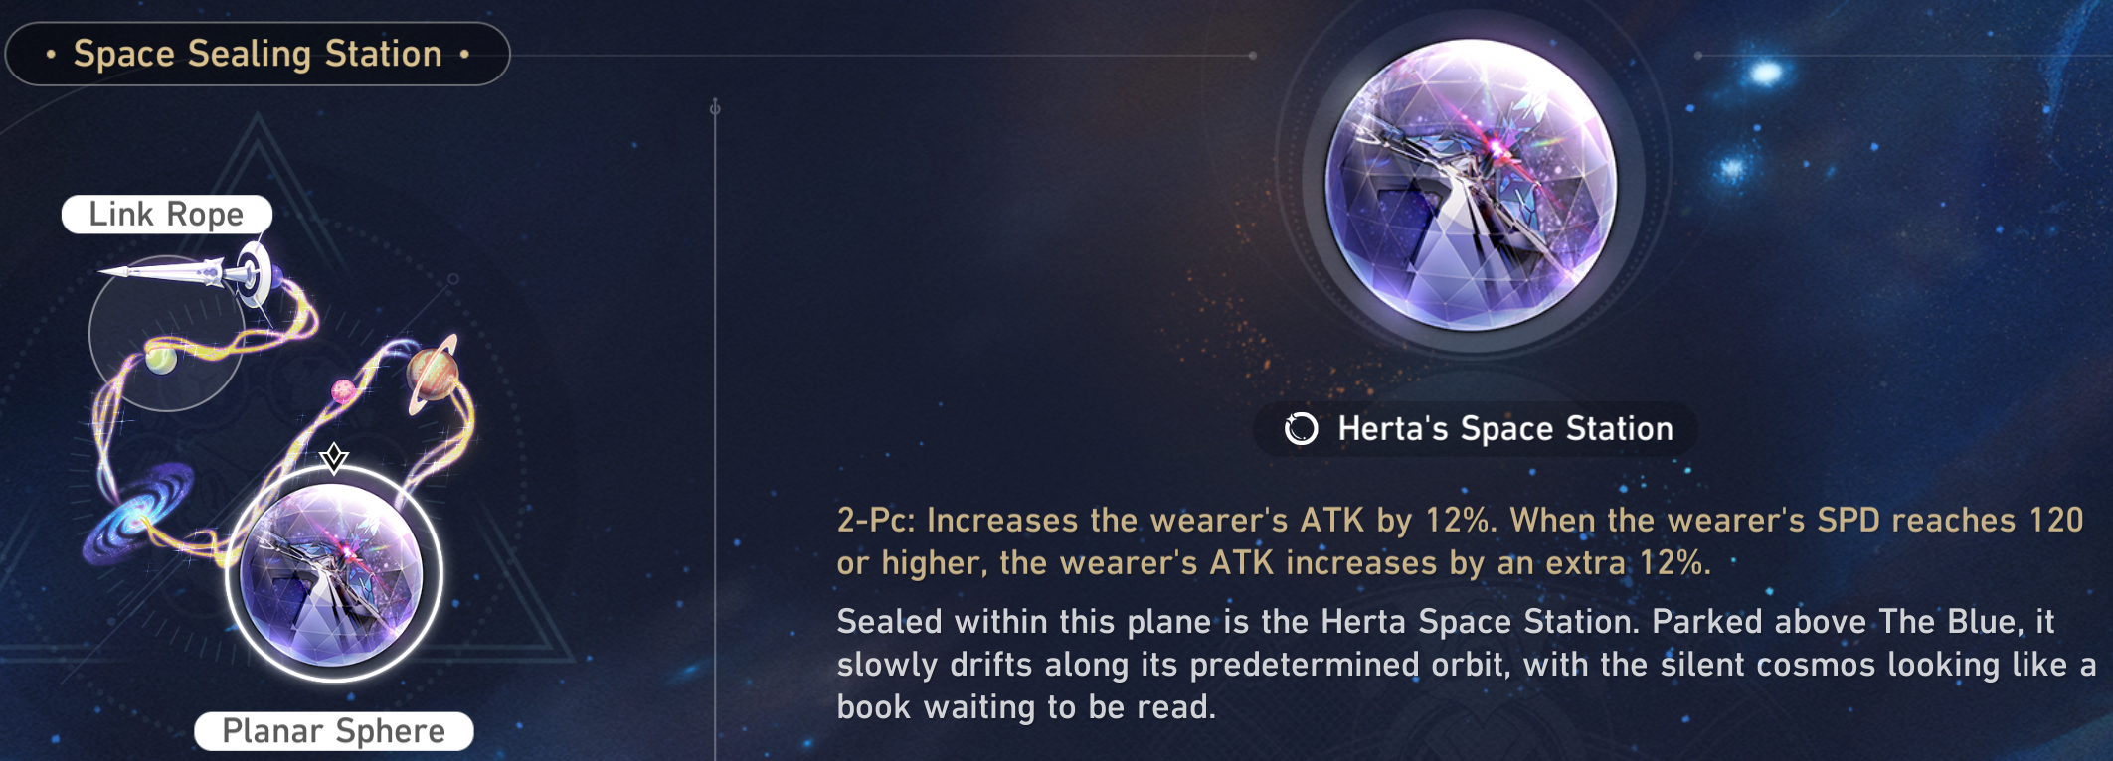
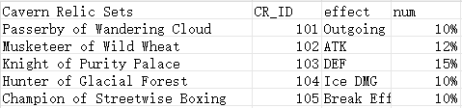
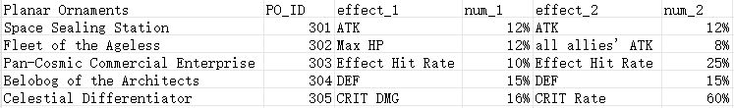
Logical Design: Relics & Ornaments
Also apply the idea ‘break down’ used in light cone relation
primary key
primary key
Conforms to BCNF:
All other attributes can be uniquely determined by CR_ID or PO_ID
Different from light cone, effects here are made into more columns insdead of adding more attributes as P.K., which satisfies the design so far.

Slide 13
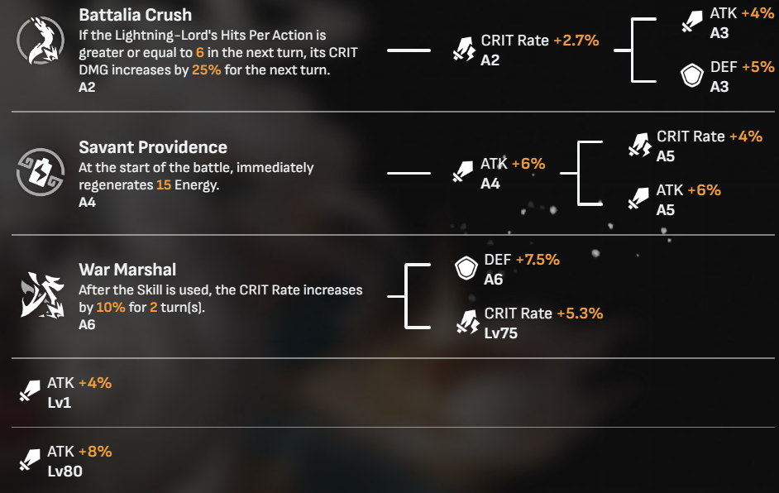
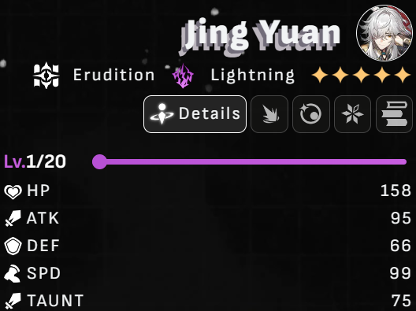
Data Sources
Collect and classify the information within the red box in the following picture using selenium and bs4 from https://starrailstation.com for every character and in-game item.

Slide 14
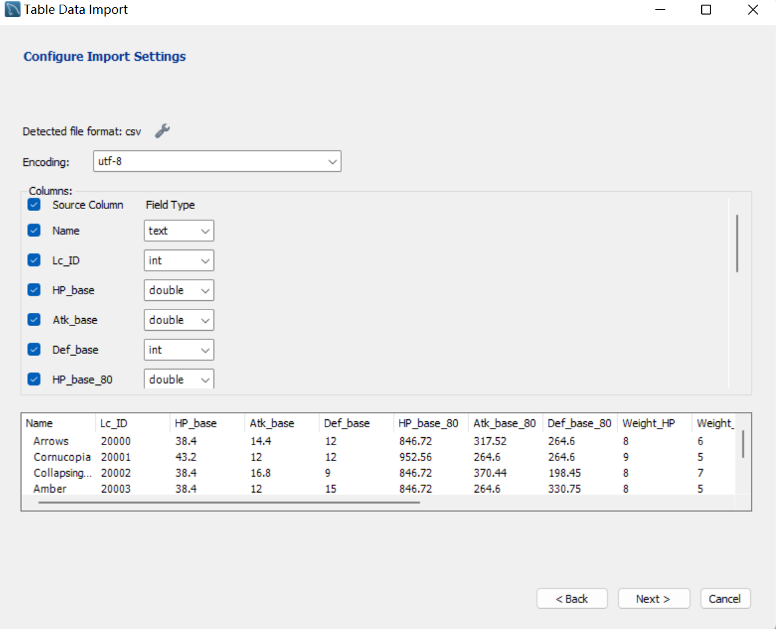
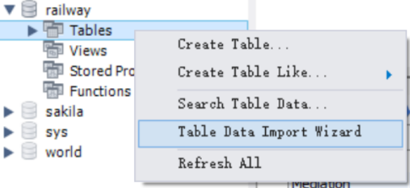
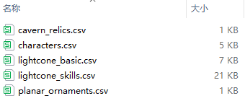
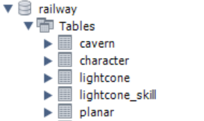
Data Import

Slide 15
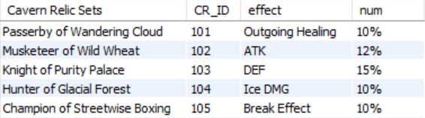
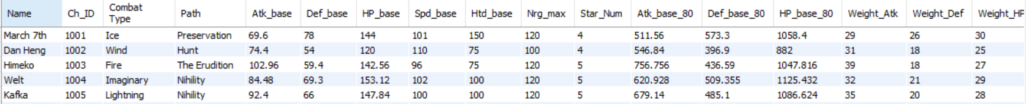
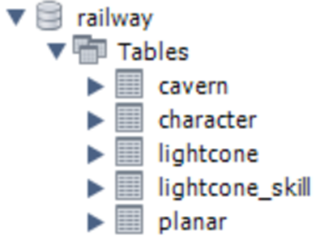
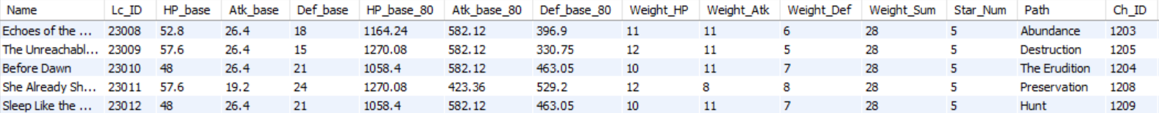
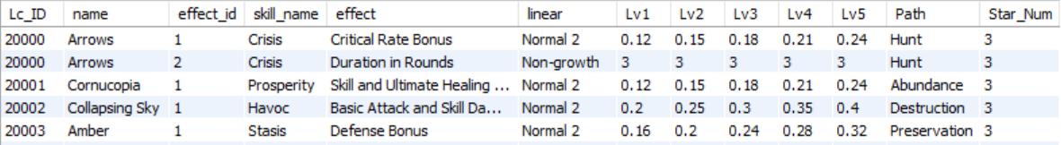
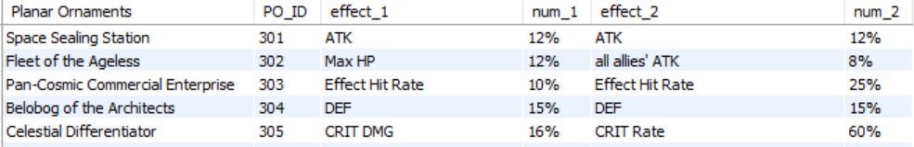
Table Presentation

Slide 16
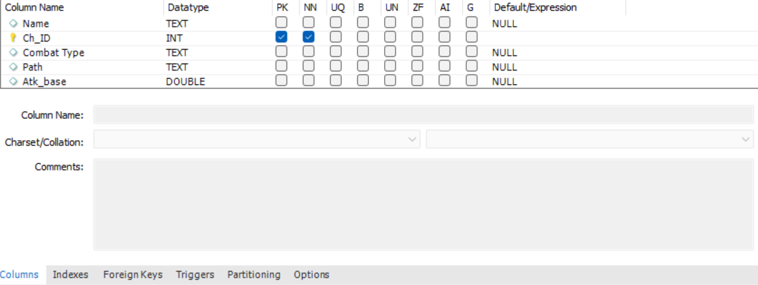
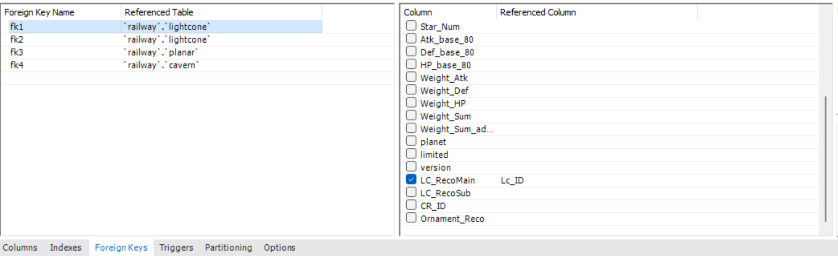
Constraint Setting
Primary Key
try
Constraint Setting
Data
Checking
Foreign Key
success
fail
Next step

Slide 17
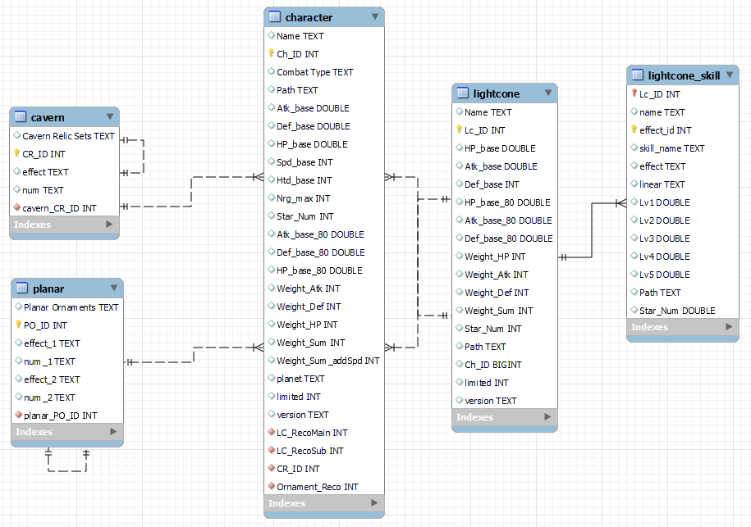
ER generated by workbench

Slide 18
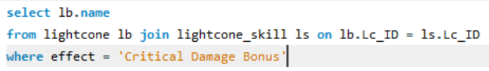
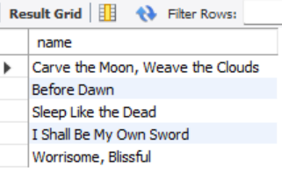
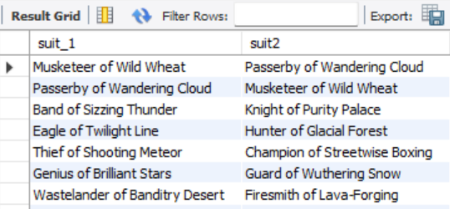

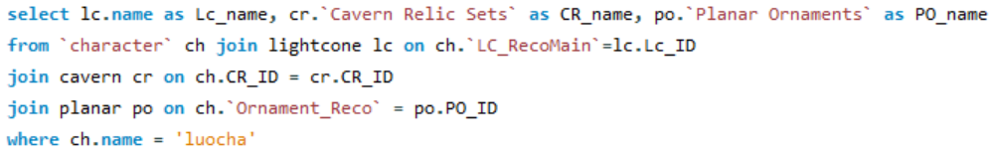
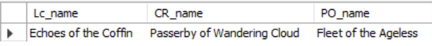
Query for Strategy
They are all practical
game scenarios!
need to improve critical damage
=> look for relevant light cones:
need to know which suits can be obtained together
=> look for relevant light cones:
need to know the recommended match for a Character
=> look for relevant light cones:

Slide 19
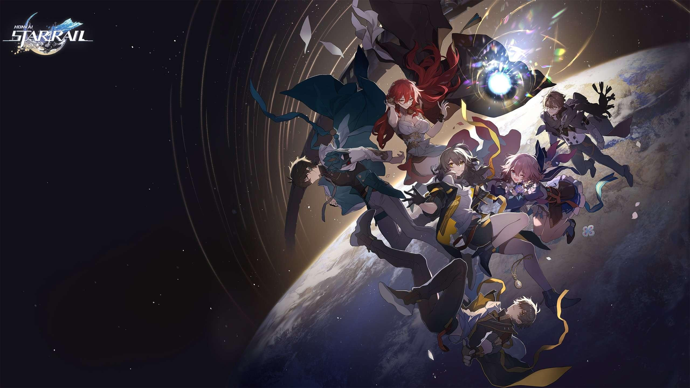
Thank you!

